Slide 1
PSY102: Introduction to Cognitive Psychology
Day 20 (06/12/19): Misinformation

Slide 2
Today’s Goals + Agenda
LO1: Continue to build a supportive classroom culture & discuss science communication
What does the science say about misinformation? How can we combat misinformation in science communication?
How did the computer game compare to our other methods of science communication?
LO2: Describe the basic fundamental principles of misinformation research
Discuss the brief section in Chpt 8 of Goldstein textbook: MPI, source misattributions (incl. demo), & wrap-up of false memory discussion
Briefly mention recent Pew research on misinformation
LO3: Summarize and critically analyze academic journal articles
What role does social media play in misinformation research? What would you say to policy makers based on this research?

Slide 3
Tomorrow’s Work
Review Day - Karl Bates visiting
Grinberg et al. (2019) (more fake news)
Lombrozo (2018) (interview w/ psychologist who studies fake news)
First draft of Duke Research blog post due
Got any Qs on editorial or publication process at the blog for Karl?

Slide 4
Memory Is Constructive
Memory = What actually happens + person’s knowledge, experiences, and expectations
Highly superior autobiographical memory (and general updating of memories, Shute, 2014)
Propranolol and consolidation
Fictional first memories
Stanley et al. (2017) - counterfactuals
Rubin et al. (2019) - scene construction
So now what are the implications of this process?

Slide 5
False Memories
Use of schemas (yesterday)
Misinformation effect (today)
Source monitoring effect (today)

Slide 6
Misinformation Effect
Misleading information presented after a person witnesses an event can change how that person describes the event later
Misleading postevent information (MPI)
E.g. Loftus et al., 1978
Notes:
Memory can be modified or created by suggestion…
Call back to “Buying Attention” podcast

Slide 7
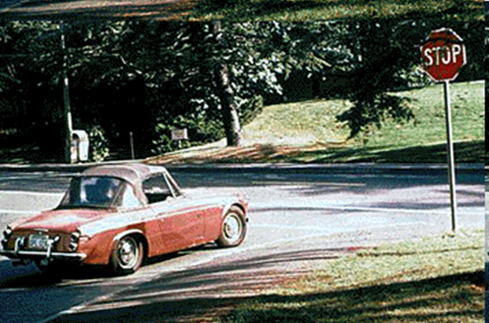
See slide show of accident:

Slide 8
Consistent
Did another car pass the red Datsun while it was stopped at the stop sign?
Misleading
Did another car pass the red Datsun while it was stopped at the yield sign?
Notes:
Difference is stop vs. yield sign
•Loftus and coworkers (1975)
–See slides of traffic accident with stop sign
–Introduce MPI: yield sign
–Participants remember what they heard (yield sign) not what they saw (stop sign)

Slide 9
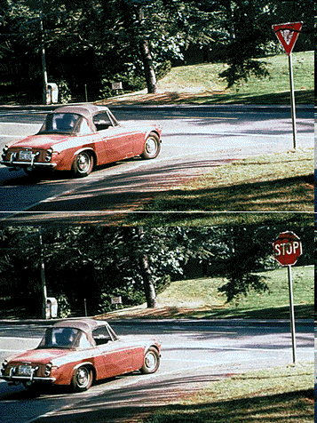
Notes:
-when they heard the misleading post-event information, more likely to then say they had seen the yield sign photo

Slide 10
Misinformation Effect
Loftus and Palmer (1974)
Showed subjects the same film of a car crash, then asked…
Group 1: “How fast were the cars going when they smashed into each other?”
Group 2: “How fast were the cars going when they hit each other?”
1 week later…
Those hearing “smashed” were more likely to report having seen broken glass than those who heard “hit”
Also said cars were going much faster if “smashed” vs. “hit”

Slide 11
Retroactive Interference
More recent learning (e.g., misinformation) interferes with memory for something in the past (e.g., the actual event)
Original memory trace is not replaced
Exposure to MPI as interference

Slide 12
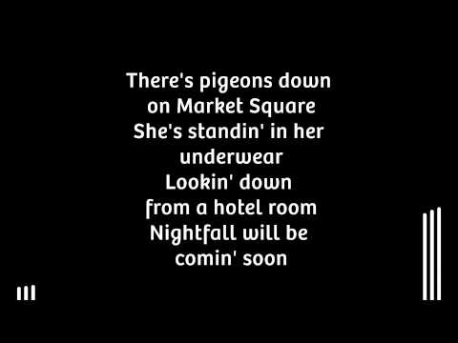
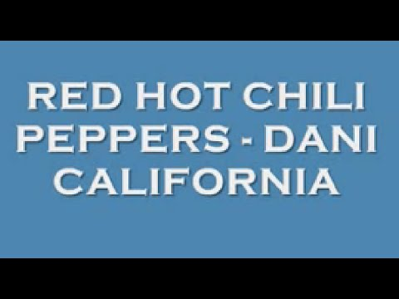
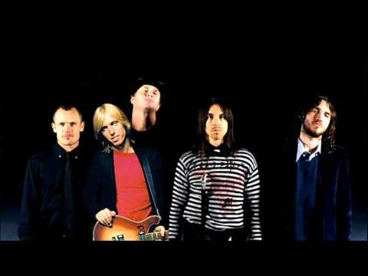
Something sound familiar…?
Notes:
https://www.youtube.com/watch?v=5ztpZq4kPRo
https://www.youtube.com/watch?v=QZmM4YeSu8g
https://www.youtube.com/watch?v=aDM8h4sl3Ng

Slide 13
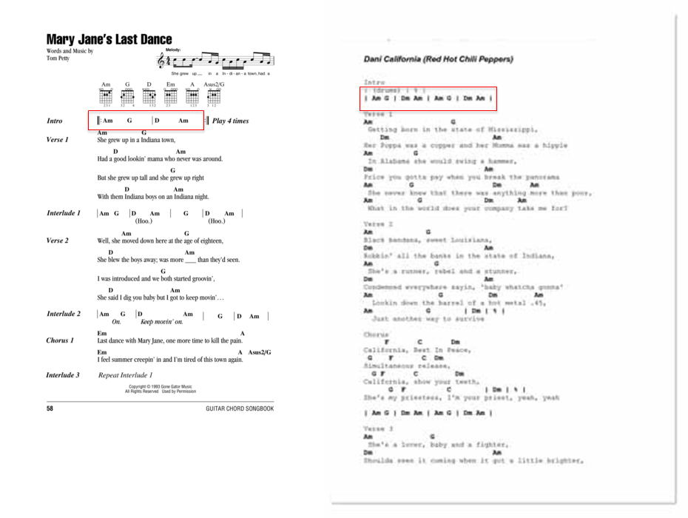

Slide 14
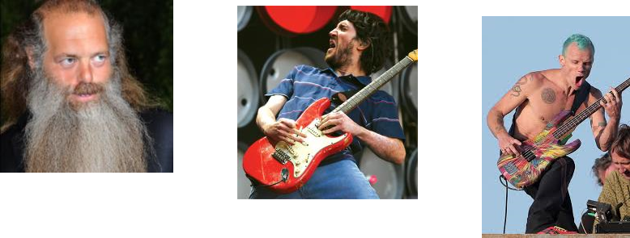
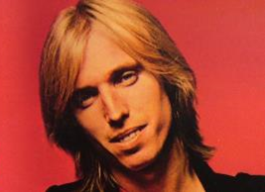
Red Hot Chili Peppers: probably sure that they had made that up
They probably just misattributed the source of the chord progression to themselves by accident.
Notes:
https://ew.com/article/2006/06/16/did-red-hot-chili-peppers-copy-tom-petty/
https://www.rollingstone.com/music/music-news/tom-petty-doubts-chili-peppers-similarity-had-negative-intent-98814/

Slide 15
MPI via Source Monitoring
Source memory: process of determining origins of our memories
Source monitoring error: misidentifying source of memory
a.k.a. “source misattribution”
E.g., War of the Ghosts story
Cryptoamnesia: Unconscious plagiarism of another’s work due to a lack of recognition of its original source
Notes:
-mechanisms that are responsible for source memory also involved in creating memory generally
-war of the ghosts story: the original story, plus details from similar stories they’ve heard about their own culture

Slide 16
Source Monitoring
Jacoby et al. (1989): “Becoming Famous Overnight”
After 24 hours, some non-famous names were misidentified as famous
Explanation: some non-famous names were familiar, and the participants misattributed the source of the familiarity
Failed to identify the source as the list that had been read the previous day
Notes:
-acquisition part of the expt: subjects read a number of made-up nonfamous names
-immediate test group: subs tested immediately after seeing the list of nonfamous names
-told to pick out the names of famous people from a list containing !) the nonfamous names they had just seen; 2) new nonfamous names they had never seen before; 3) famous names
-before the test, told that all the names they had seen were nonfamous
-W/ immediate test, correctly identified most of the old nonfamous names as being nonfamous
-But with the delayed test group, 24 h after first seeing the names (after also being told the names they had seen were nonfamous).... Now subs identify the old nonfamous names as being famous

Slide 17
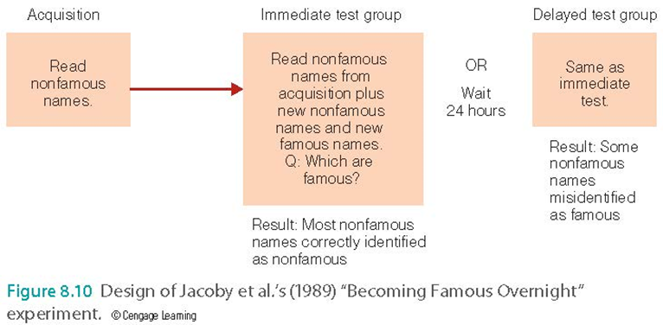
Source Monitoring

Slide 18
Source Monitoring Errors
Read statements one at a time on screen.
Statements stereotypical for males:
“I swore at the guy who insulted me”
Statements stereotypical for females:
“I made a centerpiece for the dining table”
Neutral statements:
“I am very easygoing.”
Statements presented with either Pat or Chris. No gender info given.
Then, after seeing the statement-name pairs, told Chris is heterosexual male, Pat heterosexual female.
What happens…?
Once they knew genders, subjs given source monitoring task… if subjects didn’t have a strong memory for who presented the statement, their memory was biased by what stereotypical males and females would say (i.e., attributed feminine statements to Pat, even when that’s incorrect, etc.).

Slide 19
Cryptoamnesia
Tom Petty vs. RHCP
Not enough that it sounds the same – people sample each other all the time
Needed to wrongly identify the source as themselves and fail to recognize the original source

Slide 20
Source Monitoring Errors
Cryptoamnesia is just one example
“Did you hear about the mob scene at the movie theater for the opening of The Hunger Games?” “Yes, I saw it on the 8 o’clock news…or was it trending on Facebook? I can’t remember.”
“Did you know that there’s a town in North Carolina called Batcave?” “Um, yes. I told you that.” “No way – I thought Caitlin told me that.”

Slide 21
Source Monitoring Errors
Failure to distinguish the source of the information
MPI is misattributed to the original source

Slide 22
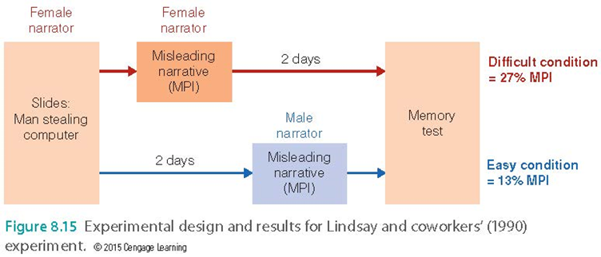
Lindsay (1990)
Heard a story; two days later again with some details changed
Told to ignore changes
Same voice for both stories created source monitoring errors
Changing voice (male to female) did not create as many errors
Notes:
-sequence of slides showing man stealing money and computer
-presentation narrated by female speaker who described what was happening as slides shown
-then divided into 2 groups…
-difficult condition heard a misleading narrative after seeing presentation… narrative read by the same female speaker (e.g., saw Folgers coffee, but narrative said coffee was MAxwell house). Brought back for memory test 2 days later
-easy condition: same misleading story, but delayed for 2 days, right before memory test; also told by male narrator.
-Both groups told to ignore information presented in the narrative
-difficult condition: easy to confuse the information (same narrator), occurred right each other
-27% MPI = responses corresponding to incorrect info from the misleading narrative

Slide 23
Hyman & coworkers (1995)
Participants’ parents gave descriptions of childhood experiences
Participant had conversation about experiences with experimenter; experimenter added new events
When discussing it later, participant “remembered” the new events as actually happening
Notes:
-like the get lost in the shopping mall incident
-like the hot air balloon video; cycling back here to yesterday’s discussion
-like fictional first memories example
-like shaw and porter (2015)

Slide 24
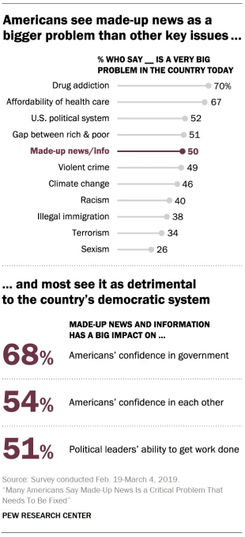
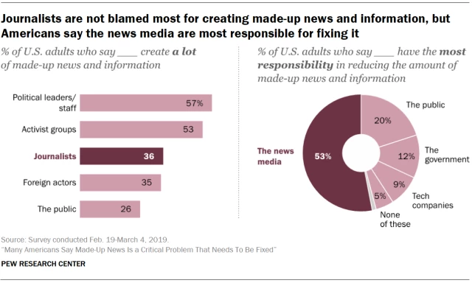
How Misinformation Impacts Our Society
Notes:
https://www.journalism.org/2019/06/05/many-americans-say-made-up-news-is-a-critical-problem-that-needs-to-be-fixed/

Slide 25
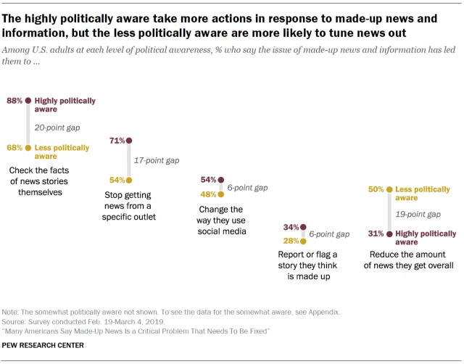
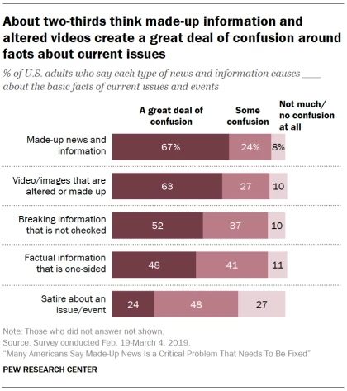
How Misinformation Impacts Our Society
Notes:
https://www.journalism.org/2019/06/05/political-leaders-activists-viewed-as-prolific-creators-of-made-up-news-journalists-seen-as-the-ones-to-fix-it/

Slide 26
Construction of Memories
Advantages
Allows us to “fill in the blanks”
Cognition is creative
Understand language
Solve problems
Make decisions

Slide 27
Construction of Memories
Disadvantages
Sometimes we make errors
Sometimes we misattribute the source of information
Was it actually presented, or did we infer it?

Slide 28
Back to your warm-up Q...
Write down a time when you found out that a memory you were pretty sure about turned out to be wrong.
Are any of these due to…
Use of schemas/scripts?
The misinformation effect?
Source monitoring errors?

Slide 29
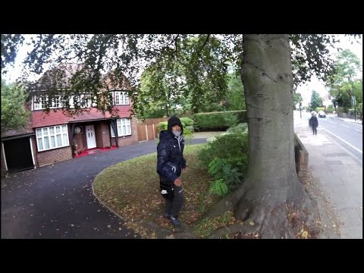
Notes:
https://www.youtube.com/watch?v=ZzChEsxjH8I&feature=youtu.be
https://www.psychologicalscience.org/uncategorized/myth-eyewitness-testimony-is-the-best-kind-of-evidence.html - Activity 2; this is a combination of misleading post-event information + false memory + eyewitness memory

Slide 30
Recognition Memory
 | Response - “old” | Response - “new”
Experiment - “old” | Hit rate | Miss rate
Experiment - “new” | False alarm rate | Correct rejection rate
Expt “old” = presented to you earlier in the experiment
Expt “new” = not presented to you earlier in the experiment
Response “old” = you said you saw it earlier in the experiment
Response “new” = you said you did not see it earlier in experiment

Slide 31
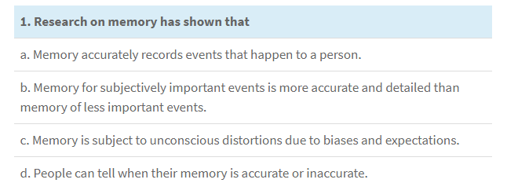
Notes:
C
https://www.psychologicalscience.org/uncategorized/myth-eyewitness-testimony-is-the-best-kind-of-evidence.html

Slide 32
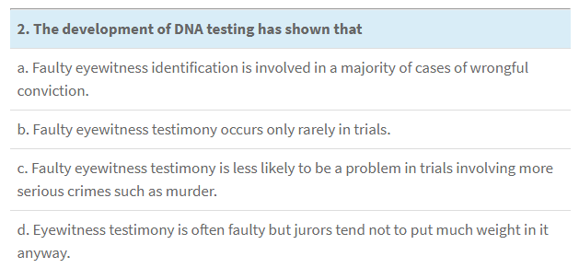
Notes:
A
https://www.psychologicalscience.org/uncategorized/myth-eyewitness-testimony-is-the-best-kind-of-evidence.html

Slide 33
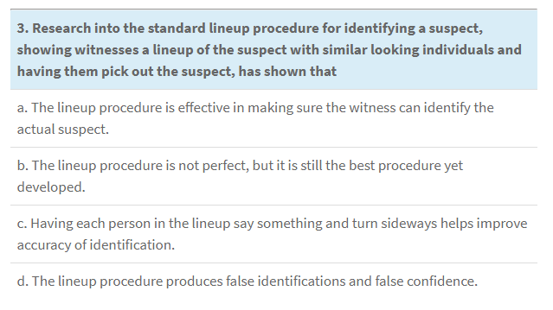
Notes:
D
https://www.psychologicalscience.org/uncategorized/myth-eyewitness-testimony-is-the-best-kind-of-evidence.html

Slide 34
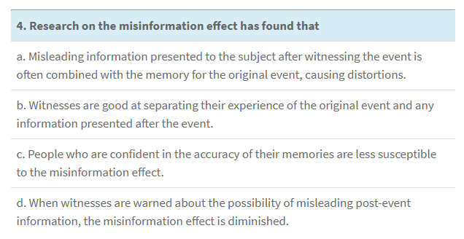
Notes:
A
https://www.psychologicalscience.org/uncategorized/myth-eyewitness-testimony-is-the-best-kind-of-evidence.html

Slide 35
Takeaways
Memory is constructive – lots of filling in the blanks, which is efficient but not always accurate
Schemas help us fill in the blanks
It’s easy to accidentally incorporate incorrect information after the fact
It’s not always easy to remember where you learned something (or came up with something)

Slide 36
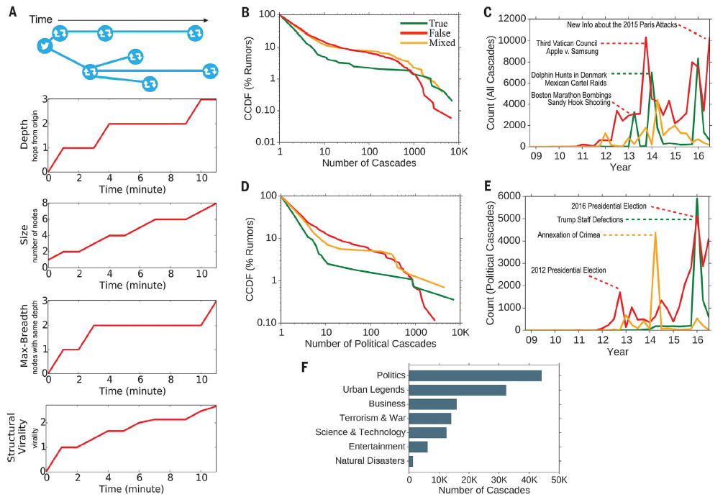
Humans are responsible for the spread of false news online?
Vosoughi et al. (2018)

Slide 37
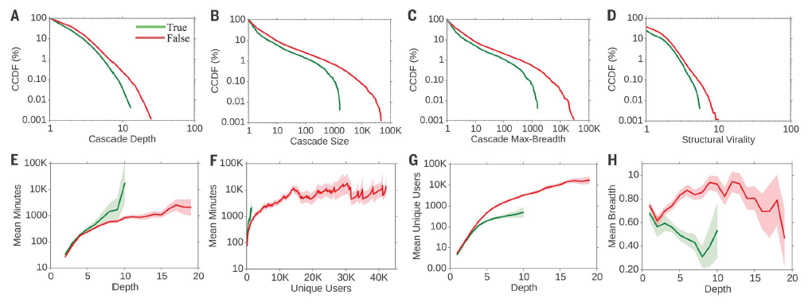
Vosoughi et al. (2018)

Slide 38
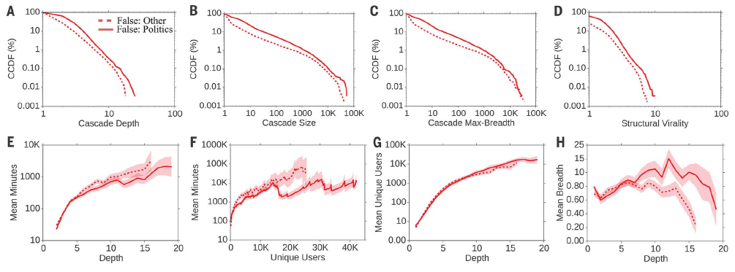
Vosoughi et al. (2018)

Slide 39
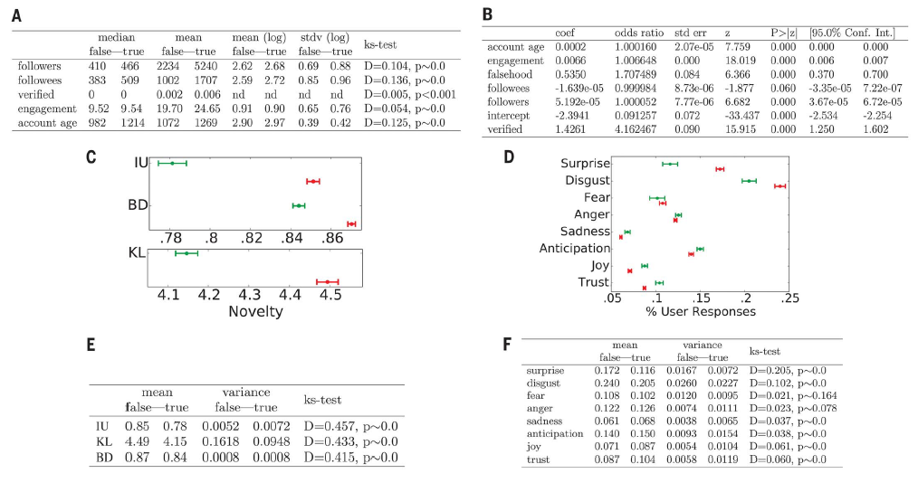
Vosoughi et al. (2018)
Notes:
-one thing I wonder is how this interacts w/ stuff on confirmation bias
-spreading false news because you want it to be true, not just because it’s novel

Slide 40
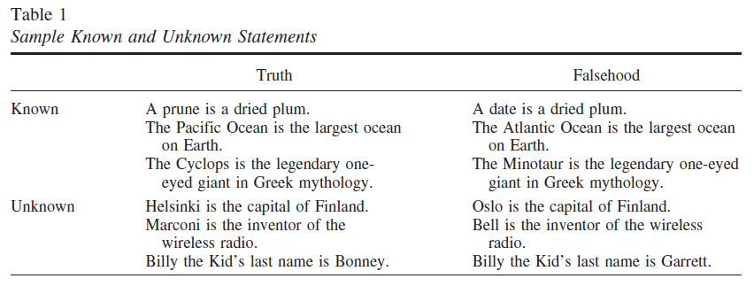
Fazio et al. (2015)

Slide 41
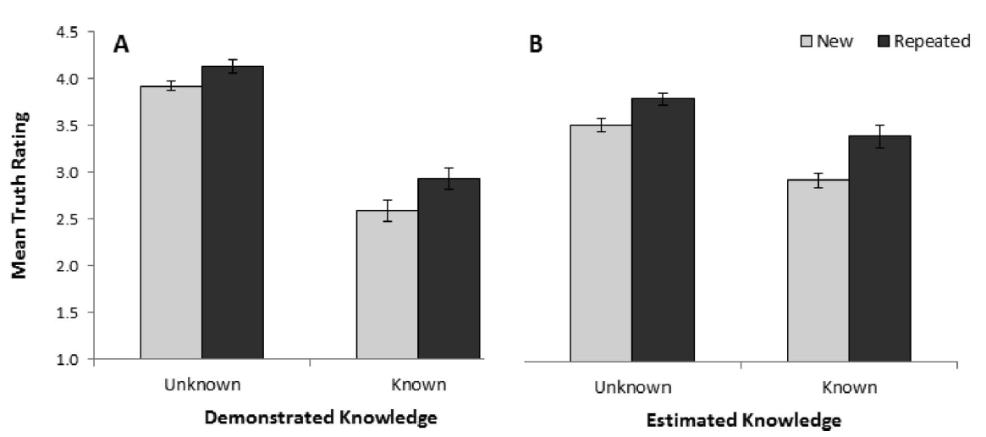
Fazio et al. (2015)

Slide 42
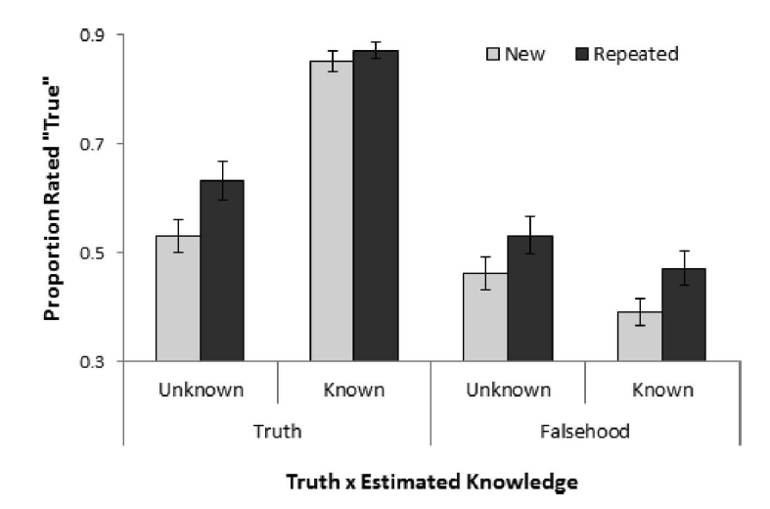
Fazio et al. (2015)

Slide 43
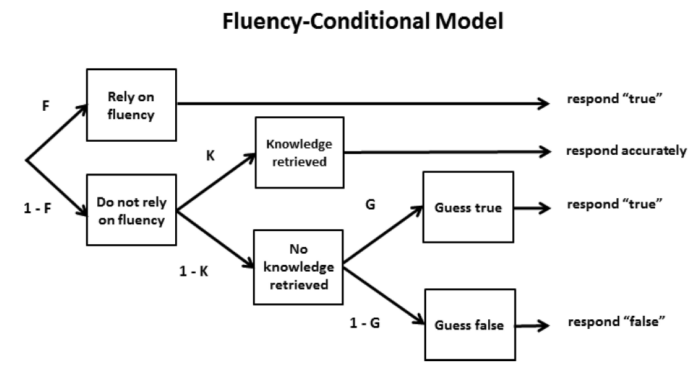
Fazio et al. (2015)

Slide 44
Follow-up to Pennycook & Rand (2018)
https://psycnet.apa.org/record/2018-46919-001
“Here we demonstrate one mechanism that contributes to the believability of fake news: fluency via prior exposure. Using actual fake-news headlines presented as they were seen on Facebook, we show that even a single exposure increases subsequent perceptions of accuracy, both within the same session and after a week. Moreover, this “illusory truth effect” for fake-news headlines occurs despite a low level of overall believability and even when the stories are labeled as contested by fact checkers or are inconsistent with the reader’s political ideology.”

Slide 45
Returning to this Q from yesterday
What would you do or recommend? What kinds of changes should be made?
Lazer et al. (2018): making lawsuits possible, government interventions, industry-academia partnerships, & more research on fact-checking; individual-level doesn’t seem like it’ll work as well
What still needs to be done, in terms of understanding more before making recommendations?

Slide 46
Today’s Goals + Agenda
LO1: Continue to build a supportive classroom culture & discuss science communication
What does the science say about misinformation? How can we combat misinformation in science communication?
How did the computer game compare to our other methods of science communication?
LO2: Describe the basic fundamental principles of misinformation research
Discuss the brief section in Chpt 8 of Goldstein textbook: MPI, source misattributions (incl. demo), & wrap-up of false memory discussion
Briefly mention recent Pew research on misinformation
LO3: Summarize and critically analyze academic journal articles
What role does social media play in misinformation research? What would you say to policy makers based on this research?

Slide 47
Participation + Minute Paper
https://tinyurl.com/PSY102Participation
https://tinyurl.com/PSY102MinutePaperJune12
https://tinyurl.com/PSY102ReviewThurs

Slide 48
Additional Practice
Optional: Test Yourself

Slide 49
Wei has allergy symptoms. He has gone to his regular doctor and an allergy specialist, but he wasn't given a prescription by either doctor. Instead, he was advised to buy an over-the-counter medicine. While he was in the specialist's waiting area, he read a magazine where he saw three ads for an allergy medicine called SneezeLess. A week later, in a drug store, Wei says to his brother, "My doctor says SneezeLess works great. I'll buy that one." Wei and his doctor never discussed SneezeLess. Wei has fallen victim to which of the following errors?
MPI
Recovered memory
Schema confusion
Source monitoring

Slide 50
Jacoby's experiment, in which participants made judgments about whether they had previously seen the names of famous and non-famous people, found that inaccurate memories based on source misattributions occurred after a delay of
One week
24 hours
One hour
One month
Follow-up: how does this expt contribute to our understanding of false memories?

Slide 51
Which of the following is the most accurate statement regarding post-event information and the misinformation effect?
The misinformation effect does not occur when people are told explicitly that the post-event information may be incorrect
Even when participants are told that the post-event information is incorrect, the misinformation effect can still occur.
Misinformation effects are significantly reduced when post-event information is provided, but only if that information is given within just a few minutes of the initial event.
The provision of accurate post-event information provided a paradoxical (and as of yet unexplained) increase in the misinformation effect

Slide 52
The retroactive interference hypothesis states that the misinformation effect occurs because
MPI obstructs or distorts memories formed during the original experiencing of an event
MPI cues the rememberer that an error in memory is occurring
MPI fills in the gaps in the original memory where it lacked detail
The original memory for an event decays over time, leaving room for MPI to infiltrate the memory later

Slide 53
In Lindsay's "misinformation effect" experiment, participants saw a sequence of slides showing a maintenance man stealing money and a computer. This slide presentation included narration by a female speaker who described what was happening in the slides as they were shown. Results showed that the misinformation effect was greatest when MPI presentation was
Visual
Auditory, regardless of the gender of the speaker
Auditory from a female speaker
Auditory from a male speaker
Follow-up: how does this expt contribute to our understanding of false memories?

Slide 54
MC Answer Key
Wei: D
Jacoby: B
Misinformation: B
Retroactive: A
Lindsay: C

